Slide 1
Community Disadvantage & Crime
Jennie Qu
Hector Dox
Wisaam Nubani

Slide 2
Introduction
Re-analysis of Krivo and Peterson’s Extremely Disadvantaged Neighborhoods and Urban Crime
Two main hypotheses
Extremely disadvantaged neighborhoods have unusually high rates of crime
Social isolation from mainstream society results in less access to jobs and less exposure to conventional role models
Lack the financial, social, and institutional resources to prevent and fight crime effectively
Local structural disadvantage is equally important in influencing crime in black and white neighborhoods
Examined crime rate in predominantly black and predominantly white high poverty neighborhoods in Columbus, Ohio
Race effects tend to be smaller than effects of disadvantage
Extreme disadvantage results in higher levels of violent crimes

Slide 3
Data Collection
Chicago Data Portal
Census data- hardship index as socioeconomic indicators
Percent of crowded housing, Percent of households below poverty, Unemployment rate, 16+ Percent aged 25+ without a high school diploma, Percent aged under 18 or 65+, Per capita income
Poverty level: 20-65 = mid, 65-100 = extreme
Crime rate
Crime count over Population in each community area
American Fact Finder
Educational Attainment
18-25 no high school diploma, 25 and over with less than 9th grade, 25 and over with no high school diploma, male with less than high school diploma, male with a high school diploma, male with a college degree, male with a bachelor’s degree or more, 'female with less than a high school diploma, female with a high school diploma, female with a college degree, female with a bachelor’s or more
Economic Data
Median household income, Mean household income, Median family income, Mean family income, Per capita income

Slide 4
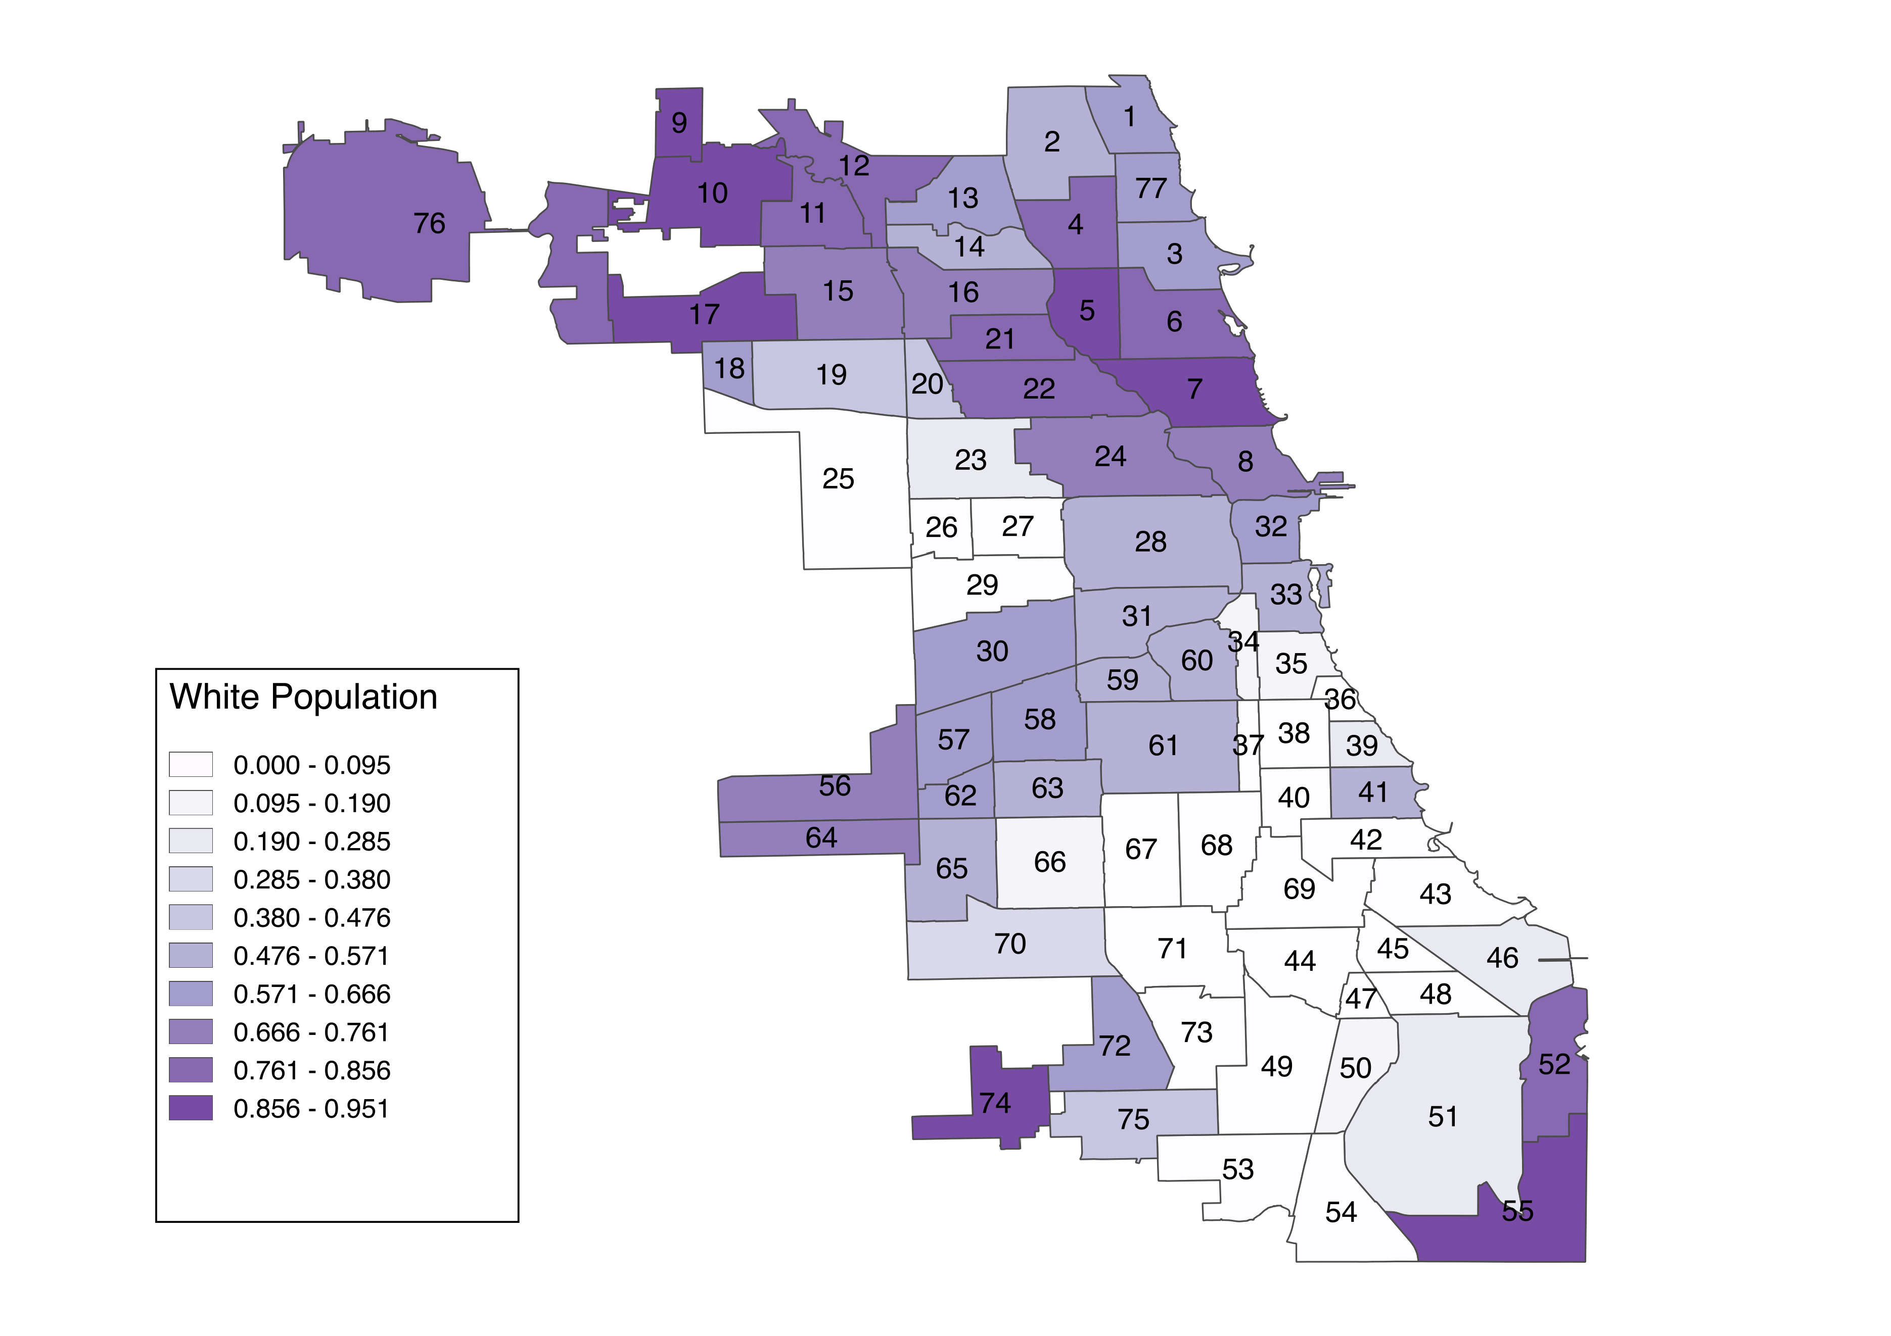
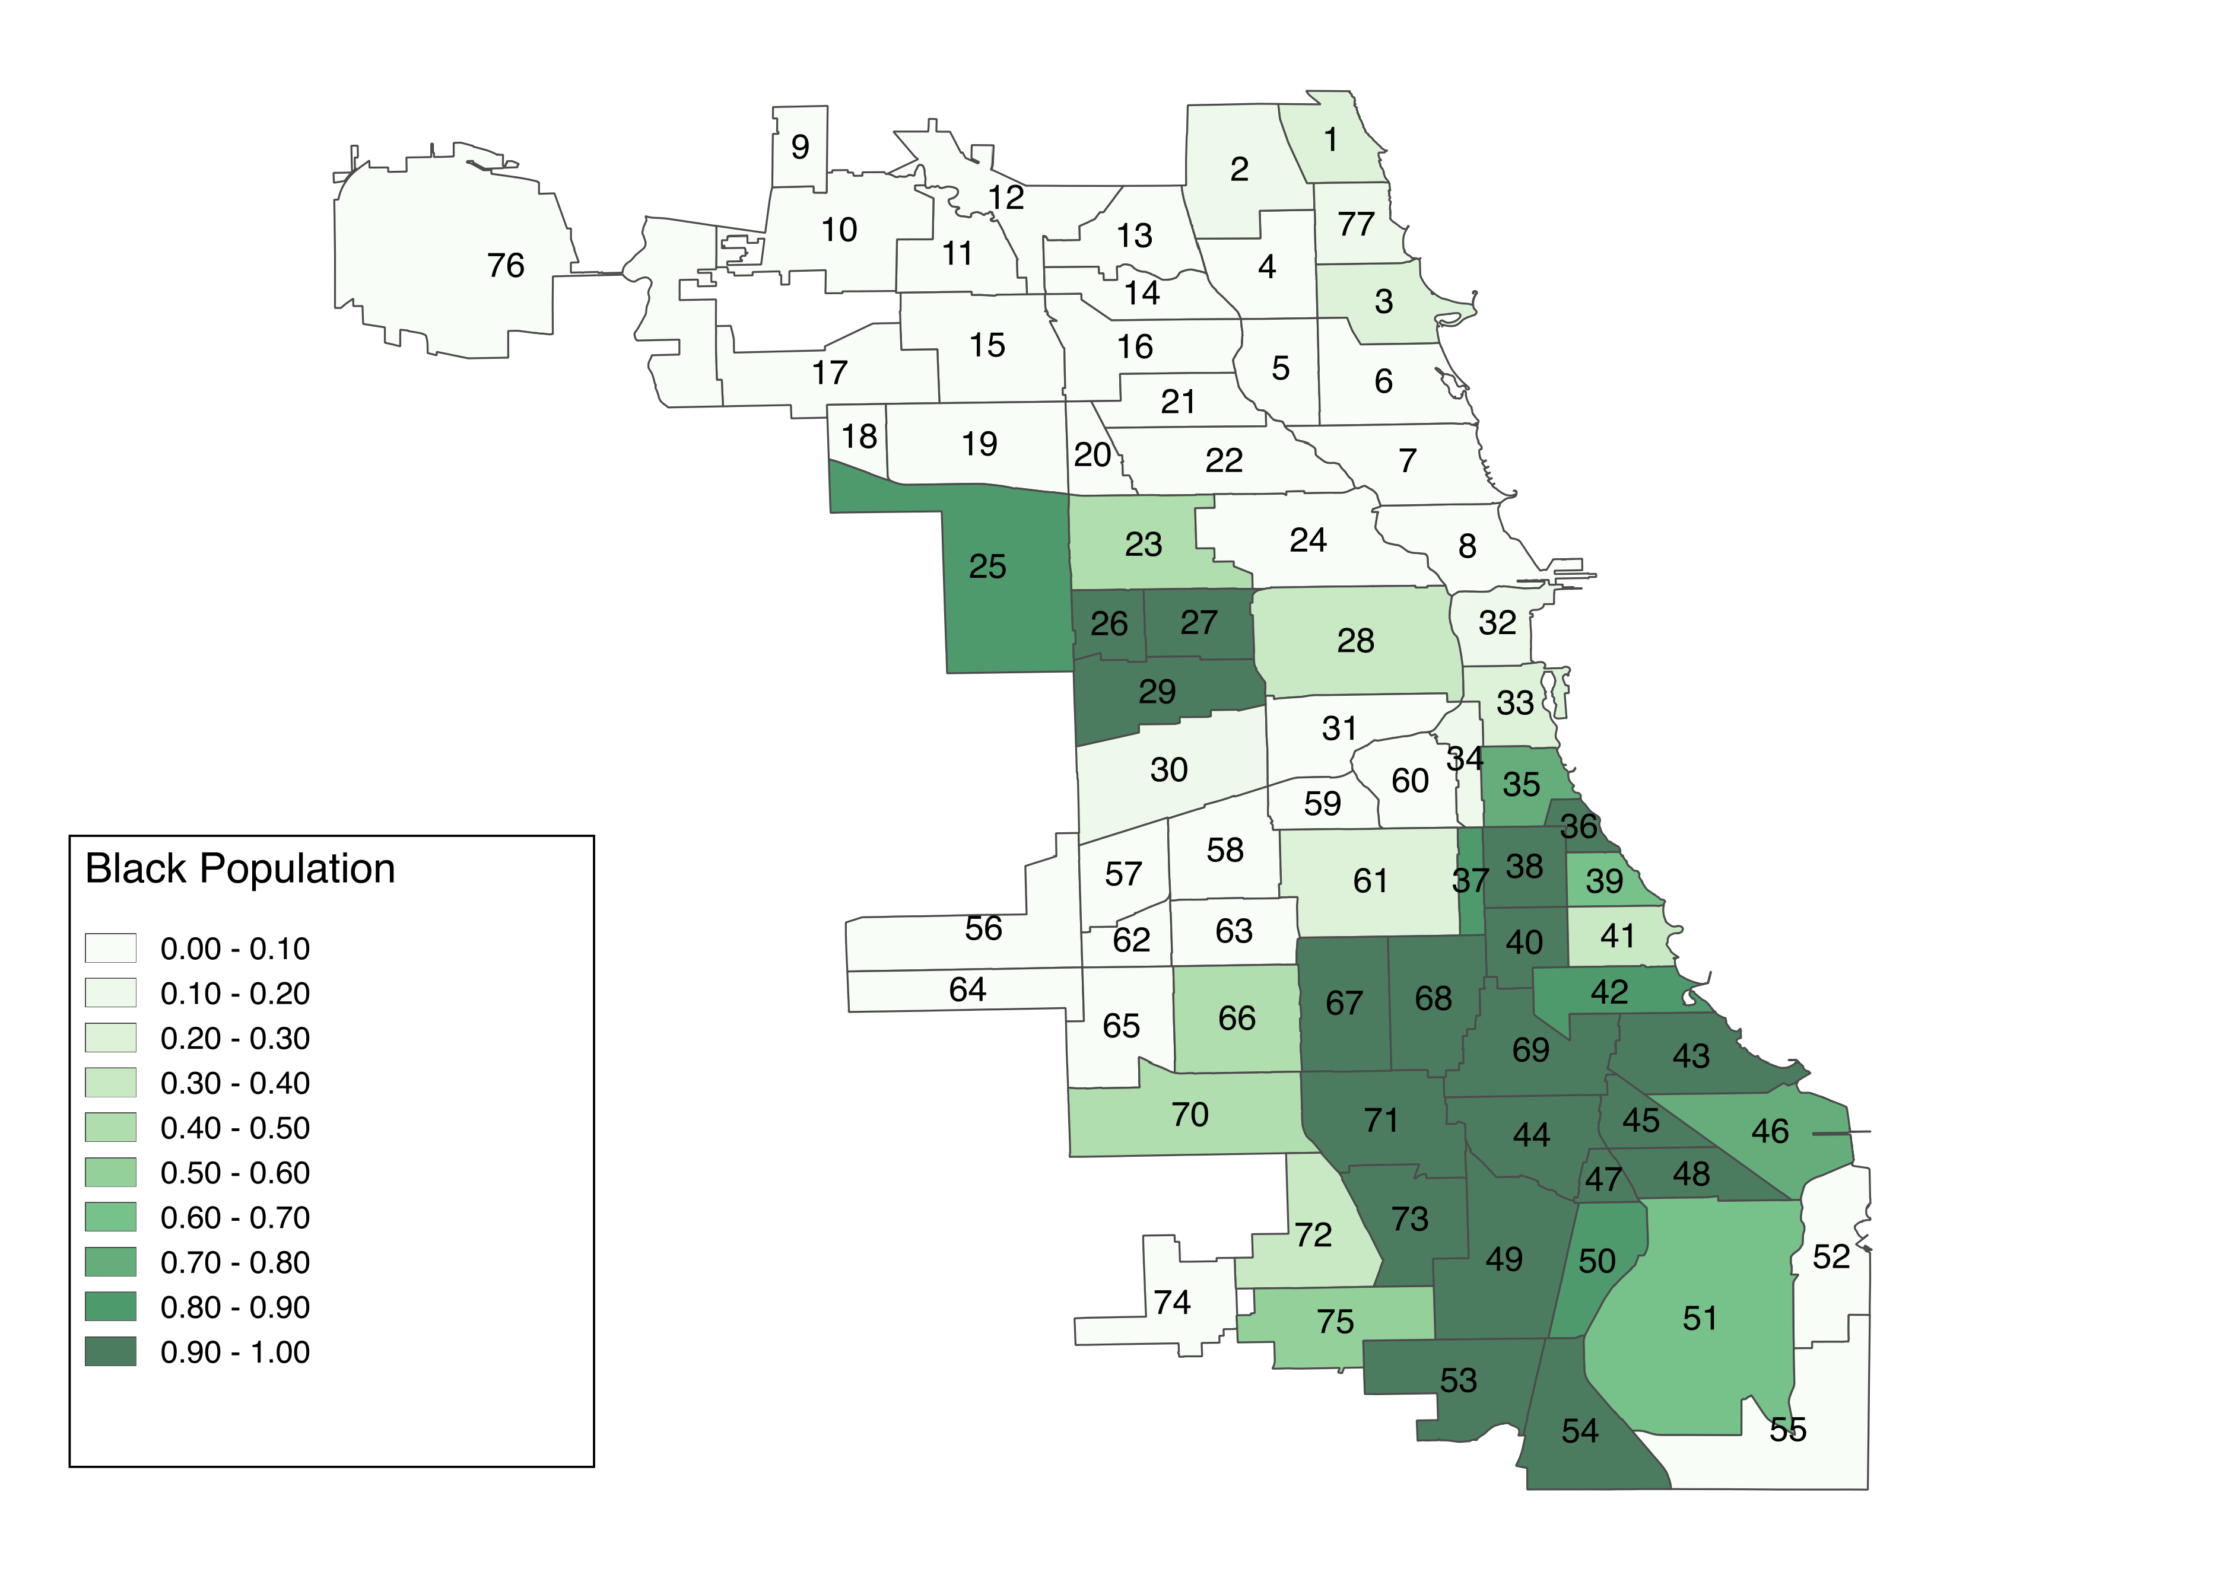
Racial Composition in Community Areas

Slide 5
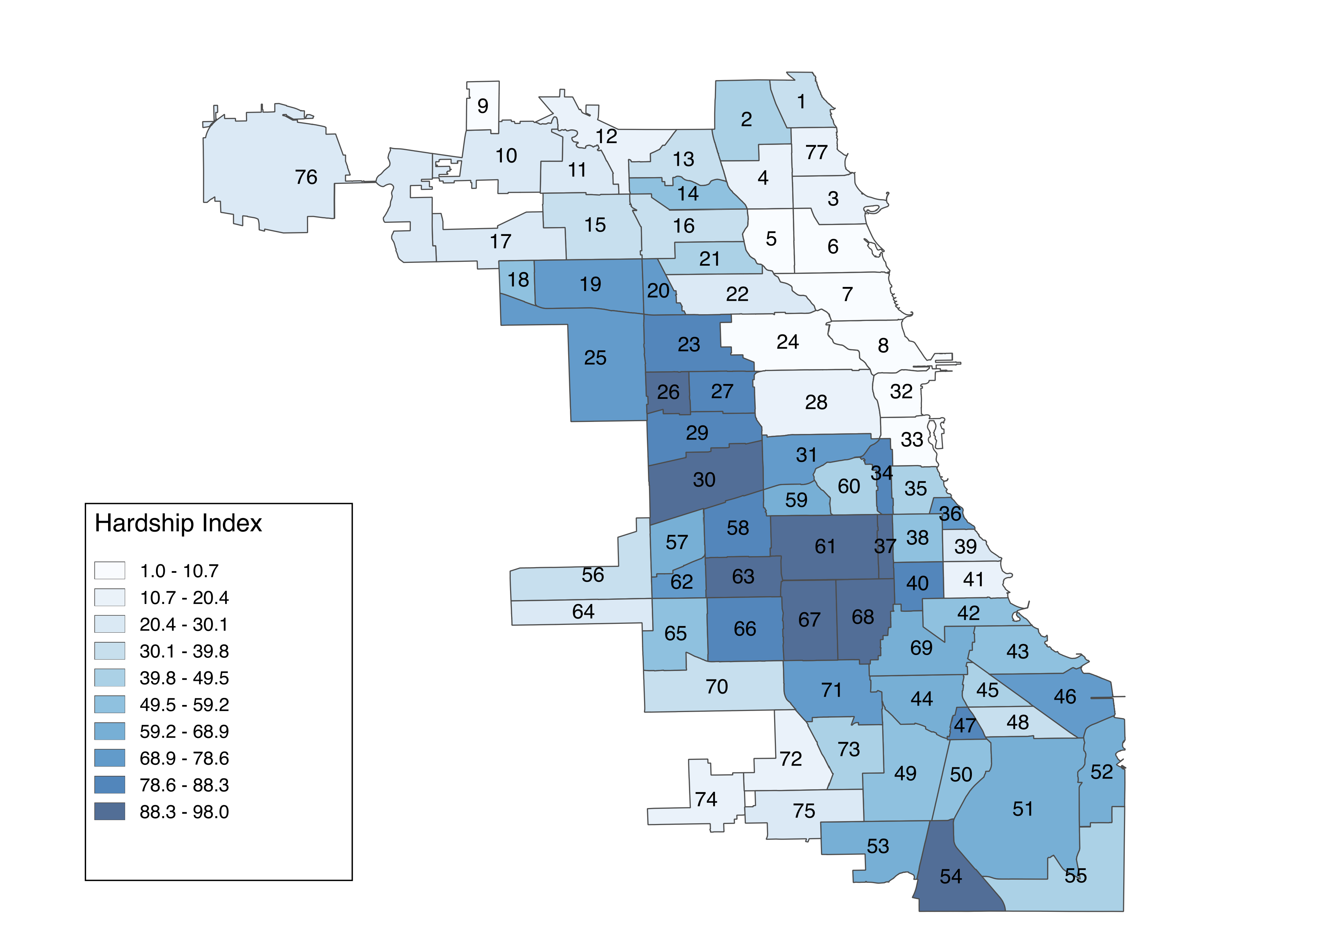
Hardship Index as an Indicator of Poverty Level

Slide 6
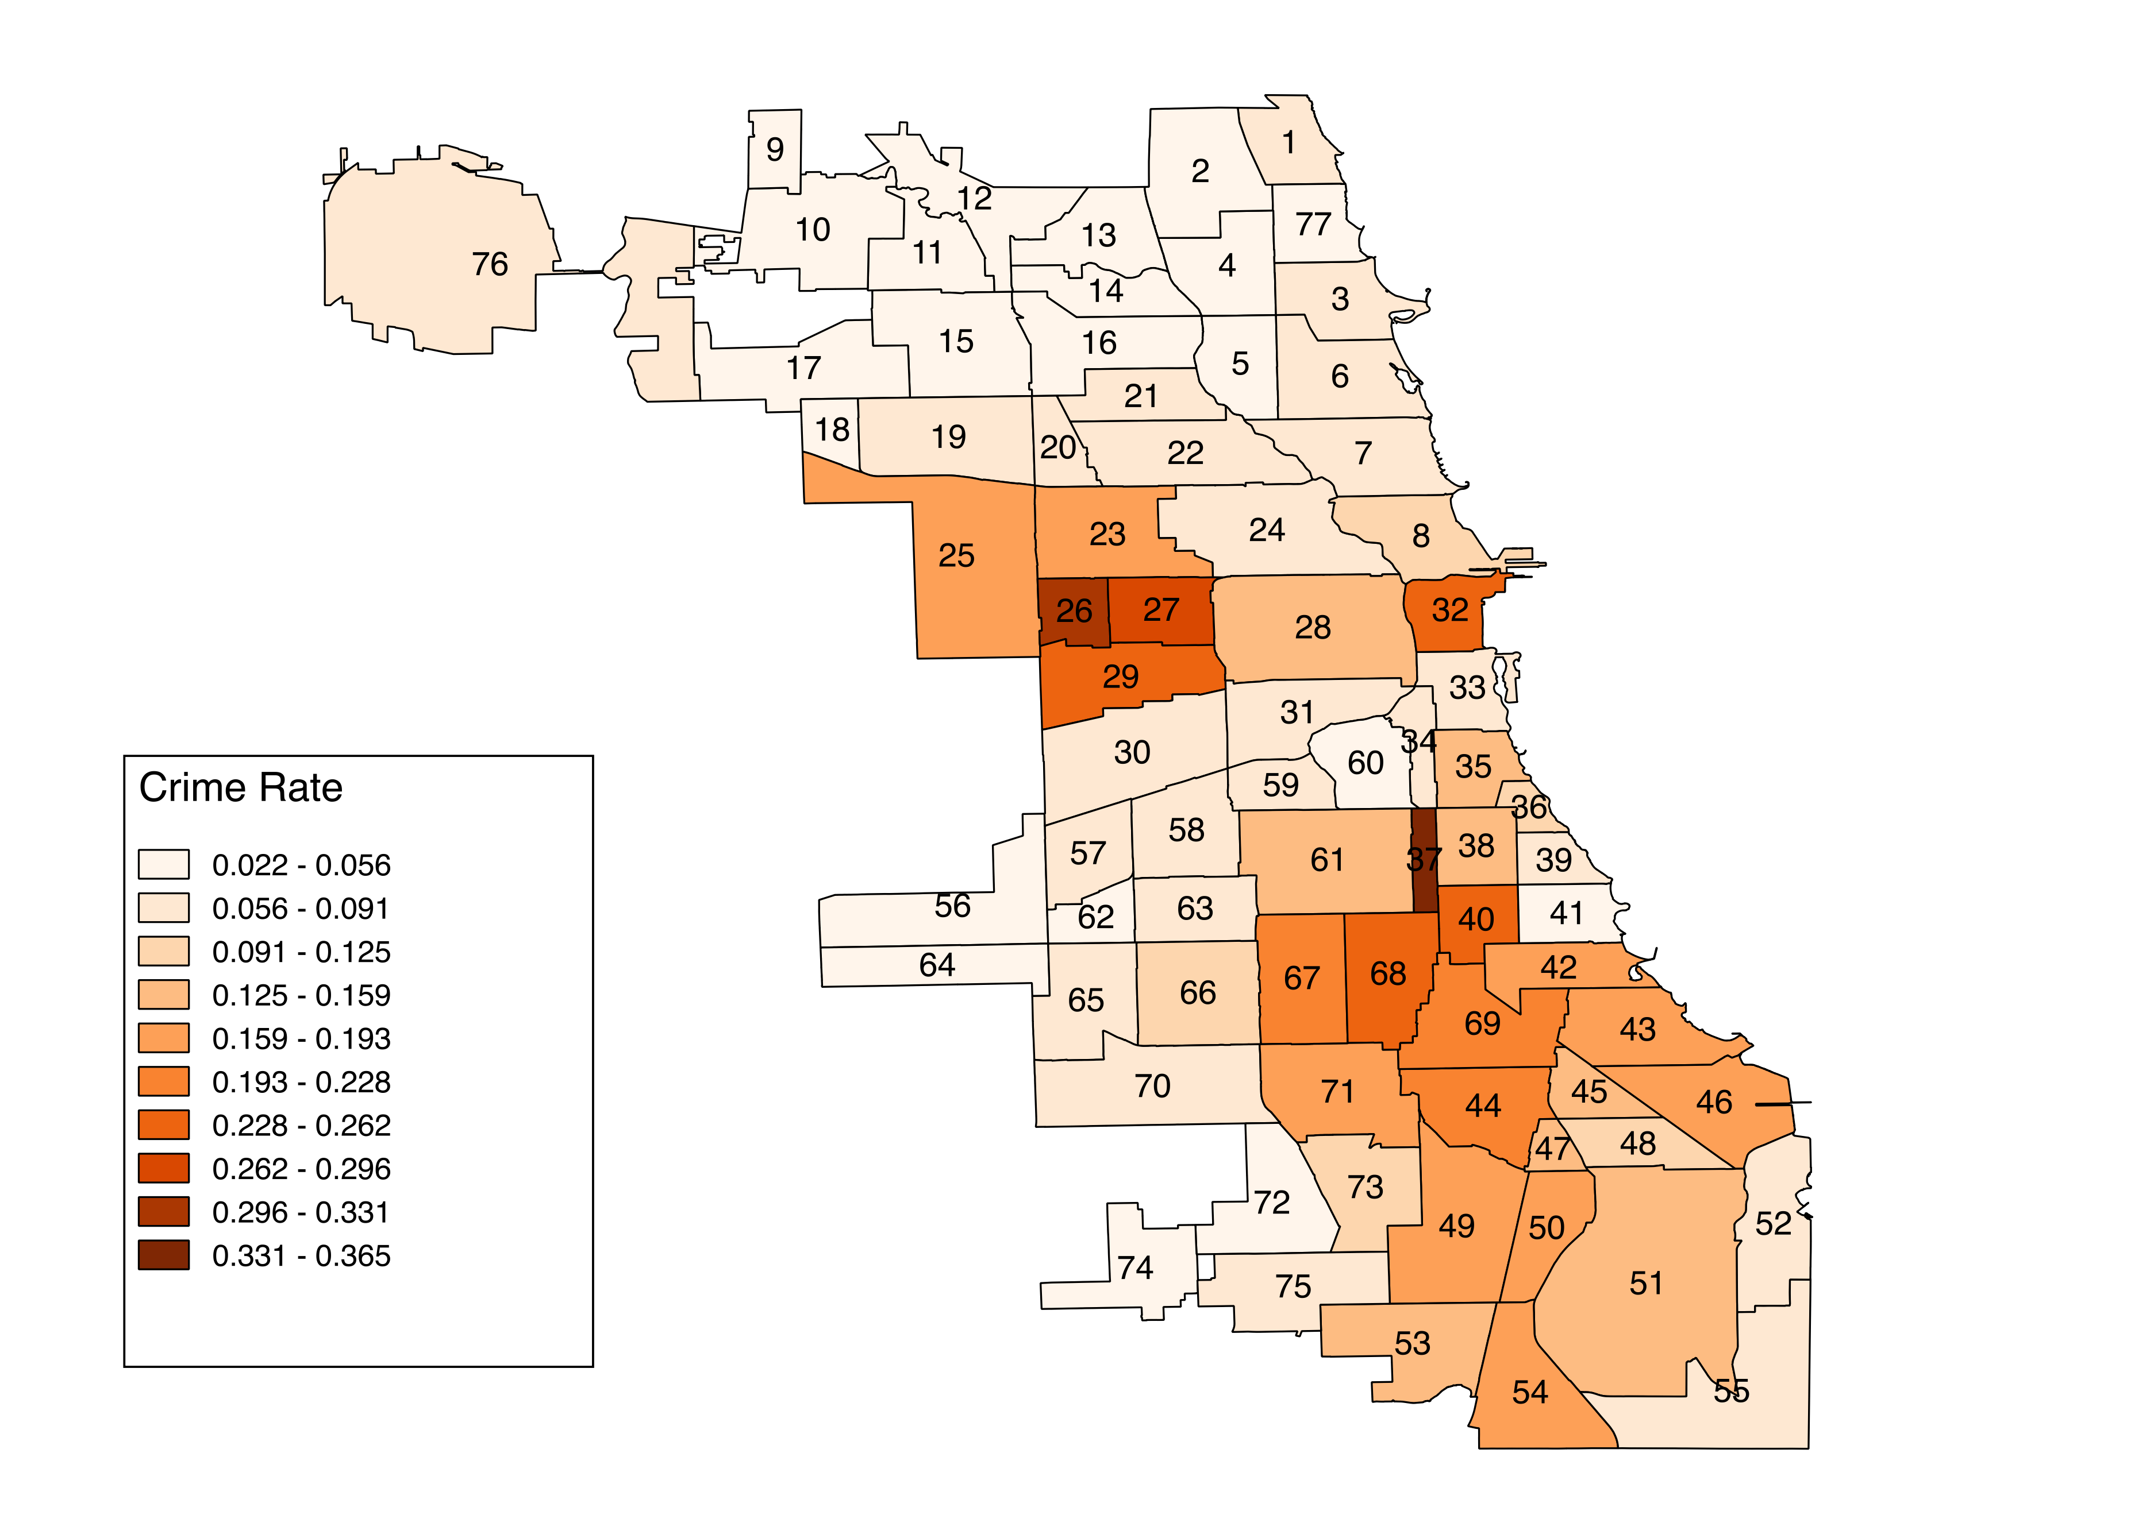
Crime Rate in Community Areas

Slide 9
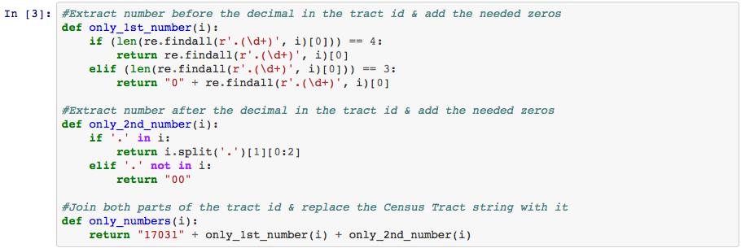
Pre Analysis Data Cleaning:

Slide 10
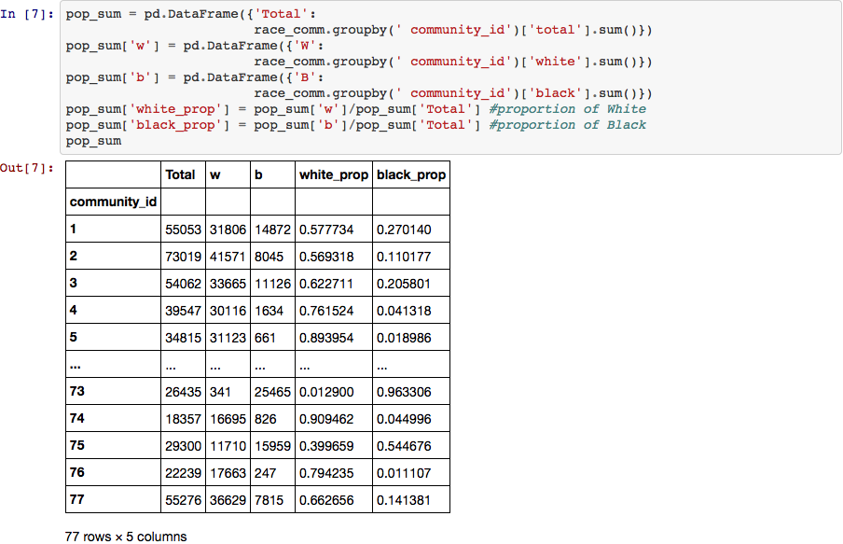

Slide 11
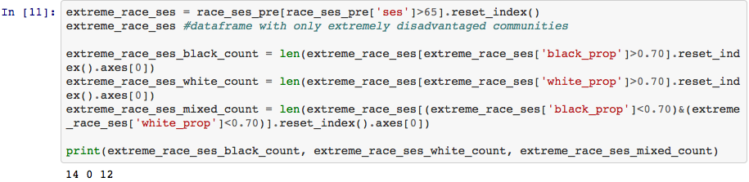
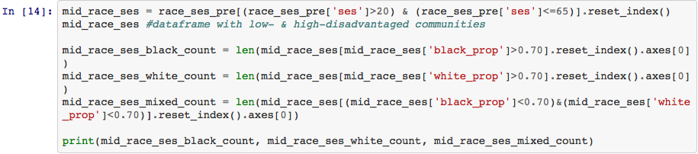
Pre Analysis Results:
Extremely disadvantaged communities: black (14) versus mixed (12)
Low & high-disadvantaged communities: black (11) versus white(11)

Slide 12
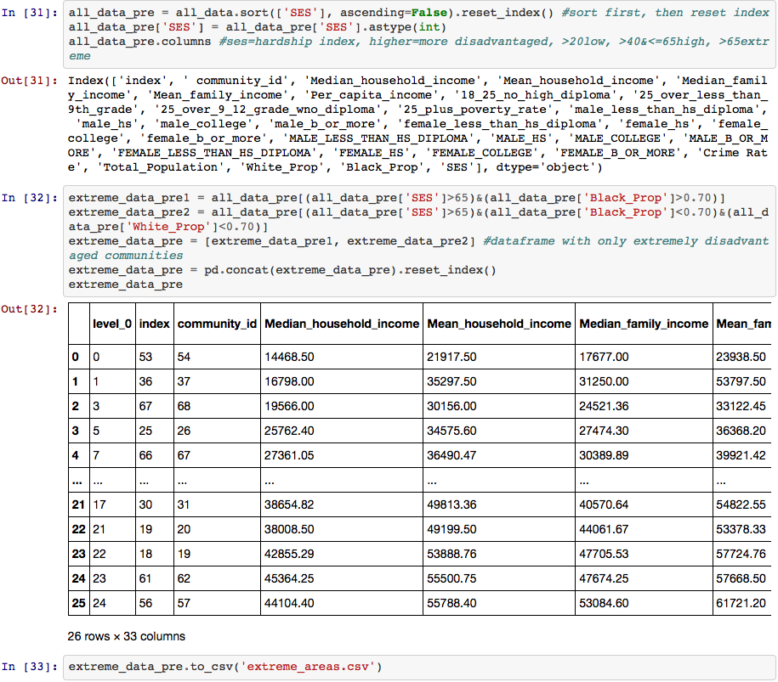
Pre Analysis Merge:
Extremely disadvantaged Black & Mixed-Race community areas’ data:

Slide 13
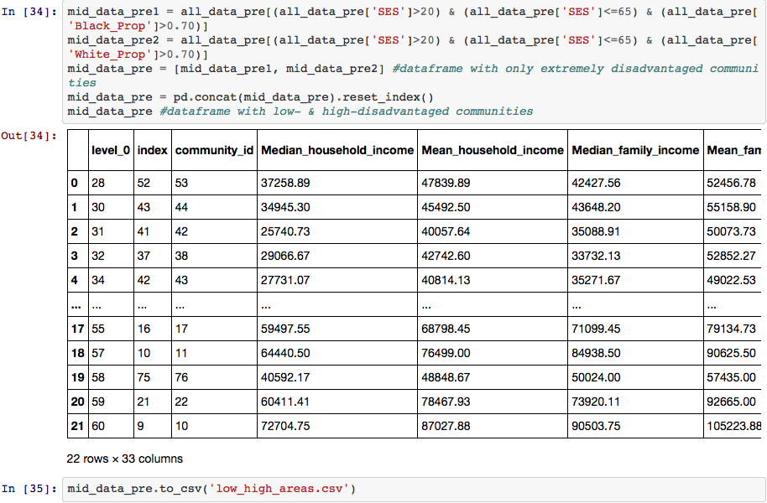
Mid-range disadvantaged Black & White community areas’ data:

Slide 14
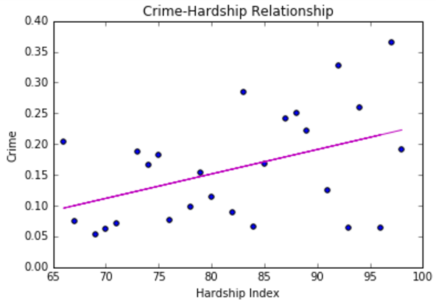
Regression Analysis
A) Extremely disadvantaged community areas
1) Crime rate & hardship index

Slide 15
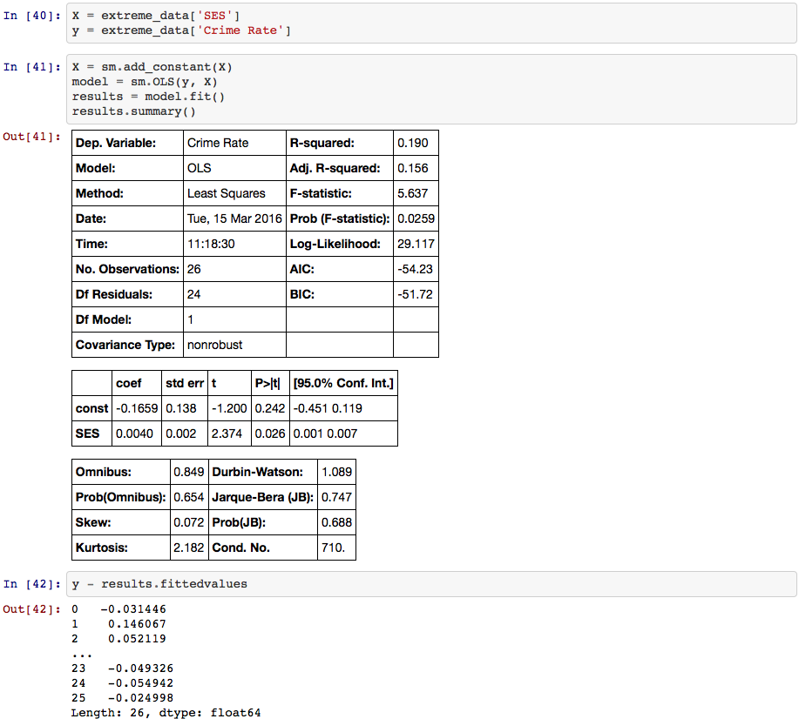
Regression Analysis
A) Extremely disadvantaged community areas
2) Crime rate & Hardship Index: significant but small effect

Slide 16
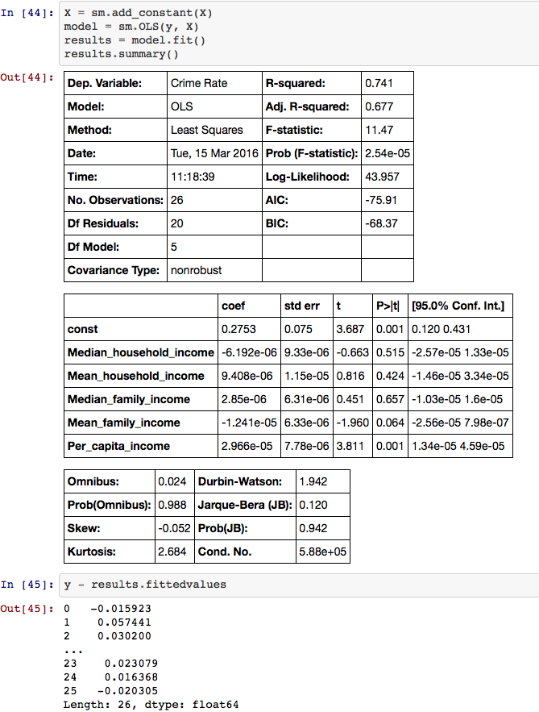
Regression Analysis
A) Extremely disadvantaged community areas
2) Crime rate & Economic data
Only per capita income found to be significant, but very small effect

Slide 17
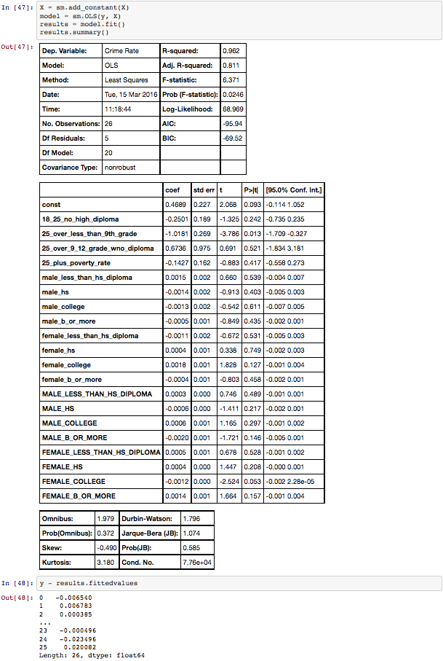
Regression Analysis
A) Extremely disadvantaged community areas
3) Crime rate & Education data
Significant
25+ year without high-school, but small effect
Female colleges, but very small effect

Slide 18
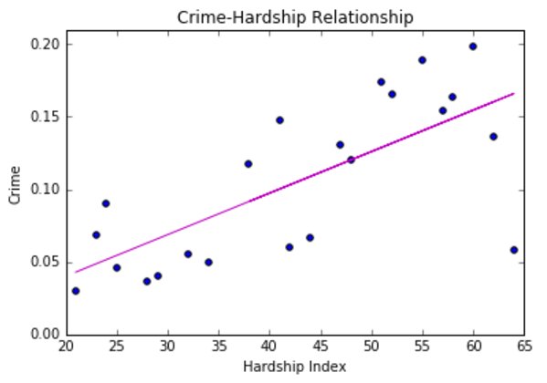
Regression Analysis
B) Mid-range disadvantaged community areas
1) Crime rate & hardship index

Slide 19
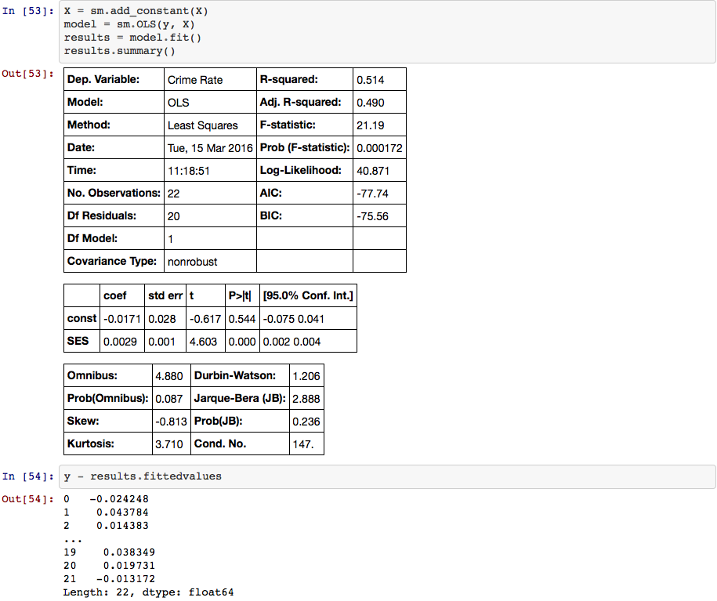
Regression Analysis
A) Mid range disadvantaged community areas
2) Crime rate & Hardship Index: significant but small effect

Slide 20

Regression Analysis
B) Mid-range disadvantaged community areas
2) Crime rate & economic data: not significant

Slide 21

Regression Analysis
B) Mid-range disadvantaged community areas
3) Crime rate & education data
Significant: education, but very small
25+ year without high-school
Males with less than high-school
Males with college education, but small
Females with less than high-school, but small
Females with less than college, but very small

Slide 22
Implications
In extreme poverty, the hardship indicator and some economic and education data were found to have significant effects on crime rates but comparable neighborhoods are not available.
In mid range poverty the hardship indicator and education data were found to have significant effects on crime rates in predominately white and predominately black neighborhoods, but the effects were very small.
Krivo and Peterson cannot be replicated in the Chicago context because of racial segregation of poverty.
The hypothesis that factors, other than race, are the true drives of crime needs to be tested in other geographies.

Slide 23
Limitations & Future Directions
Choice of city and groups of comparison
Assessing extreme poverty rather than mid poverty and comparing it to low poverty
Choosing a less segregated city with identical numbers of predominantly black and predominantly white extremely disadvantaged neighborhoods
Choice of statistical model
Utilizing other hierarchal models / prediction models
Choice of indicators
Including more indicators outside of economic/education data
Differentiate between different types of crime

